Slide 1
Section 4
2022-02-04

Slide 2
Allocating memory
#include <stdlib.h>
You will have to allocate and free memory in this assignment
  Use either malloc or calloc
Allocating memory
  void *malloc(size_t size);
    The malloc() function allocates size bytes and returns a pointer to the allocated memory. The memory is not initialized.
  void *calloc(size_t nmemb, size_t size);
    The calloc() function allocates memory for an array of nmemb elements of size bytes each and returns a pointer to the allocated memory. The memory is set to zero. If the multiplication of nmemb and size would result in integer overflow, then calloc() returns an error.
malloc(n * sizeof(int)) ~= calloc(n, sizeof(int));
  Only approximately equal
    Malloc does not set the memory to anything - Calloc sets all to 0
    If n *sizeof(int) > UINT_MAX, then calloc will not tell you - it will just give you bad memory
Note: size_t is normally just an unsigned long integer - corresponds to memory width (64bits) and hence addressable space in memory

Slide 3
Freeing memory
#include <stdlib.h>
All dynamically allocated memory asked for by you must also be freed by you
void free(void *ptr);
  The free() function frees the memory space pointed to by ptr, which must have been returned by a previous call to malloc(), calloc(), or realloc(). Otherwise, or if free(ptr) has already been called before, undefined behavior occurs. If ptr is NULL, no operation is performed.
    Undefined behaviour means bad times
      Just how invalid pointers often just resulted in weird outputs, same can happen here
When do you free?
  When you no longer need the memory

Slide 4
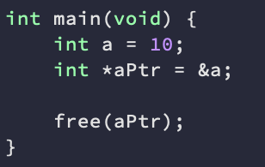

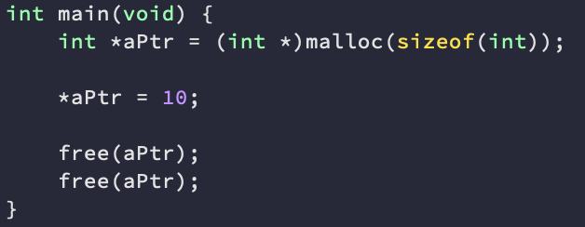
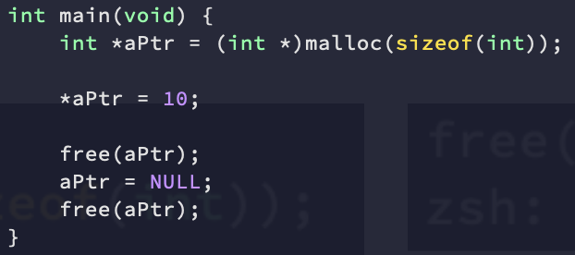
Examples
Tried to free a local variable (it was not dynamically allocated)
Tried to free an already freed pointer
Some implementations of free are nice enough to point this out!
This is why we normally set freed pointers to NULL
Works!
free(NULL) is a no-op
You still don’t want to do this on purpose though

Slide 5
Structs
Allows us to group variables together
Keep related variables together
  E.g. student id and student name
Accessing structs
  Using the dot operator
  E.g.
typedef struct name {
<variable declarations>
}typedef_name;
typedef struct Course {
char *name;
int num_enrolled;
}Course;
Course c;
c.num_enrolled = 10;
c.name = “CSE13s”;

Slide 6
Structs cont.
Structs can contain any type inside them (including their own type)
  Have to use the struct name, not the typedef name though
    Why? - typedef only finishes executing after the complete declaration of the struct!
typedef struct Course {
char *name;
int num_enrolled;
Course *prereq;
}Course;
typedef struct Course {
char *name;
int num_enrolled;
struct Course* prereq;
}Course;

Slide 7
Last bit about structs
Will this work?
typedef struct Node {
int val;
struct Node next;
}Node;

Slide 8
Last bit about structs
NO!
  What does this mean?
    When we create structs, we need to allocate all their memory at once
    How much memory would we have to allocate for this struct?
      We don’t know
Need to use a pointer to reference itself
  Pointers use up a fixed amount of memory
typedef struct Node {
int val;
struct Node *next;
}Node;

Slide 9
Allocating and freeing structs
Just like any other type!
  Node *n = (Node *)malloc(sizeof(Node));
    sizeof tells us how much memory we need to allocate!
      Why sizeof(Node) not sizeof(Node *)?
    The part in brackets is called a cast
      Tells the compiler to treat the returned value as a (Node *) type
  free(n);
    Frees the memory used by the struct n
    IF you need to free things that are pointed to by the struct, free them first!

Slide 10
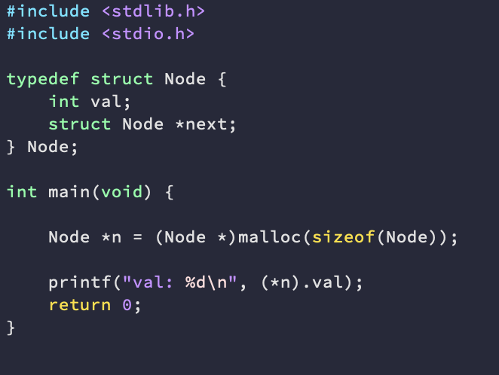
What does this print?

Slide 11
Answer
We don’t know!
  From malloc: The memory is not initialized.
  If we use calloc, we know it will print 0

Slide 12
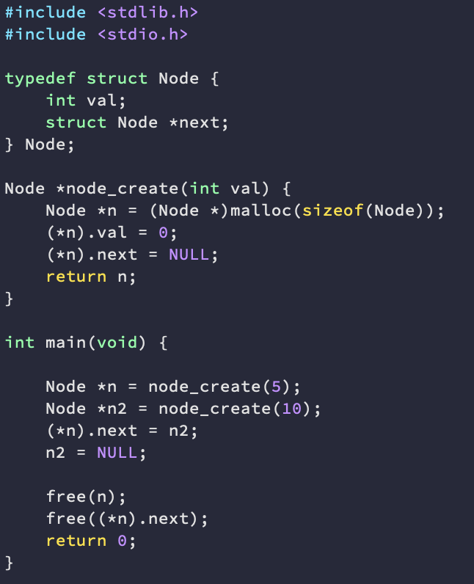
Will this work?

Slide 13
Answer
No
  We are trying to access a member variable of the struct after it has already been freed
    The result of this is undefined!
We need to switch the order of frees around

Slide 14
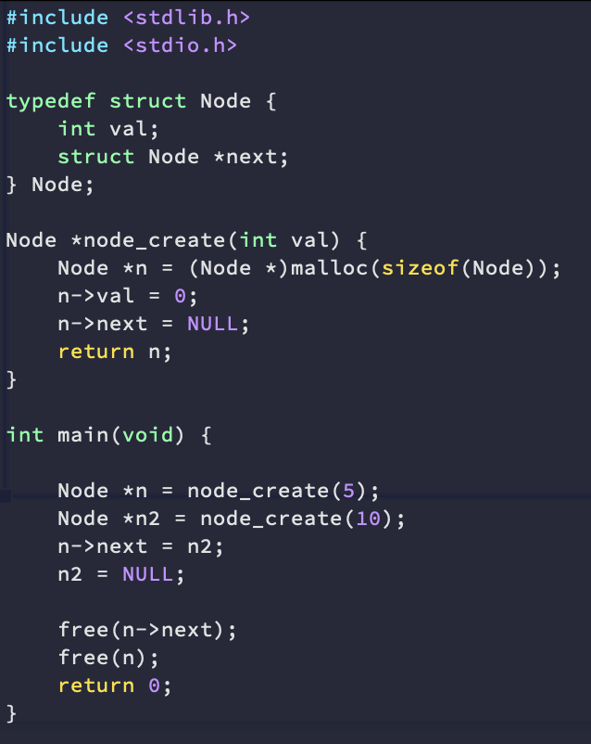
Accessing struct members
Typing out (*n).val is tiring! - If only there was a shorthand like for arrays!
a->b
  Arrow is shorthand for exactly this!
    a->b == (*a).b

Slide 15
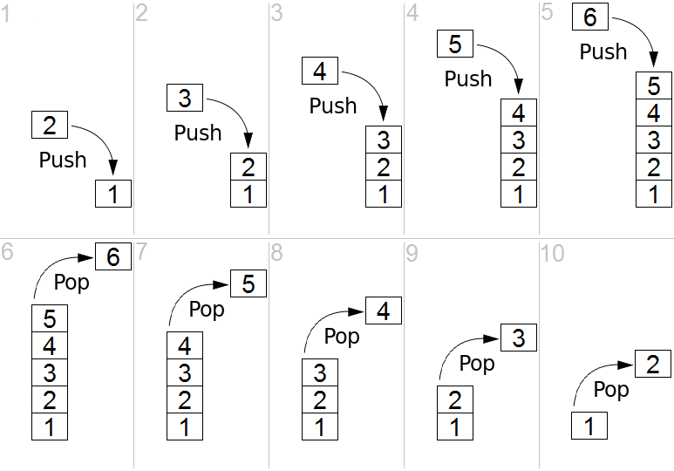
Stacks
LIFO - Last in First Out
2 basic operations
  Push - put an item on the stack
  Pop - take an item off the stack
https://en.wikipedia.org/wiki/Stack_(abstract_data_type)

Slide 16
Reverse Polish Notation (RPN)
A way to implement a calculator without needing brackets!
Uses a stack
Operands (values) are pushed onto the stack when read in
Operators (+,-,*,/) pop off 2 items from the stack, and push the result of the operation back on the stack
E.g. 3 + 8 - 5 * 4
  This would be: 3, 8, +, 5, 4, *, -
  Let's work through this!

Slide 17
RPN notation
Stack
Input remaining: 3, 8, +, 5, 4, *

Slide 18
RPN notation
Stack
Input remaining: 8, +, 5, 4, *, -
3

Slide 19
RPN notation
Stack
Input remaining: +, 5, 4, *, -
8
3

Slide 20
RPN notation
Stack
Input remaining: 5, 4, *, -
Read:
Pop
+
8
3

Slide 21
RPN notation
Stack
Input remaining: 5, 4, *, -
Read:
8
3

Slide 22
RPN notation
Stack
Input remaining: 5, 4, *, -
Read:
Pop
3
+
8

Slide 23
RPN notation
Stack
Input remaining: 5, 4, *, -
Read:
Push
3
+
8
=
11

Slide 24
RPN notation
Stack
Input remaining: 4, *, -
5
11

Slide 25
RPN notation
Stack
Input remaining: -
* read:
4
5
11

Slide 26
RPN notation
Stack
Input remaining: -
* read:
Pop
*
4
5
11

Slide 27
RPN notation
Stack
Input remaining: -
* read:
5
*
4
Pop
11

Slide 28
RPN notation
Stack
Input remaining: -
* read:
5
4
Push
*
=
20
11

Slide 29
RPN notation
Stack
Input remaining:
- read:
20
11

Slide 30
RPN notation
Stack
Input remaining:
- read:
Pop
-
20
11

Slide 31
RPN notation
Stack
Input remaining:
- read:
Pop
11
-
20

Slide 32
RPN notation
Stack
Input remaining:
- read:
11
-
20
=
Push
-9

Slide 33
RPN notation
Stack
Input remaining:
-9

Slide 34
Things to note
The first thing you pop off is the subtractor / denominator for division and subtraction
Hw3.c Reads in input.txt for you and calls the stack
You only have to implement the stack and the calculation operations!

Slide 35
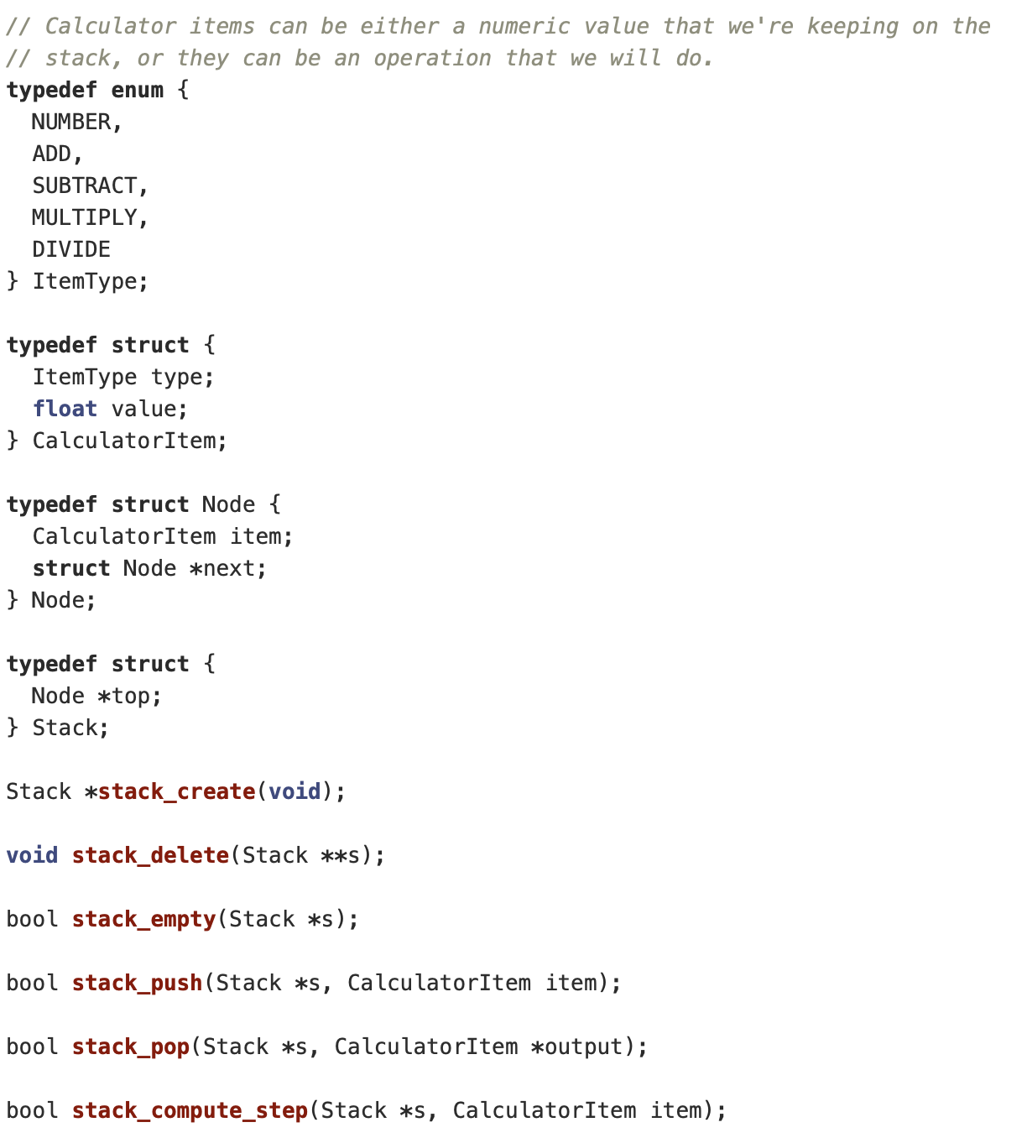
Other important things
item->type tells you if you should add item->value to the stack, or perform an operation
  Everything will be fed in through stack_compute_step
Functions return booleans - if they succeeded or not
  Remember to return false if something failed! (e.g. not enough operands)

Slide 36
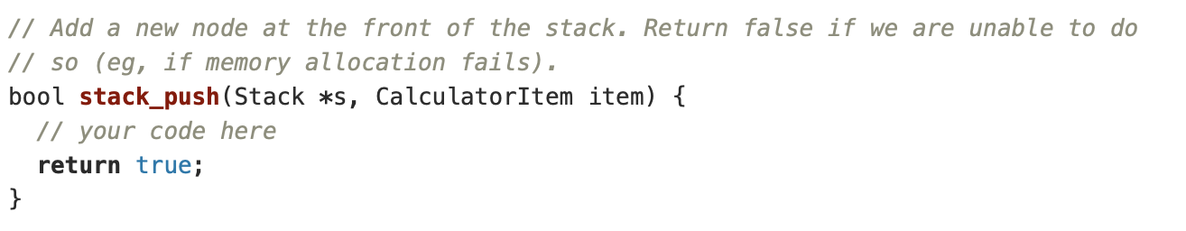
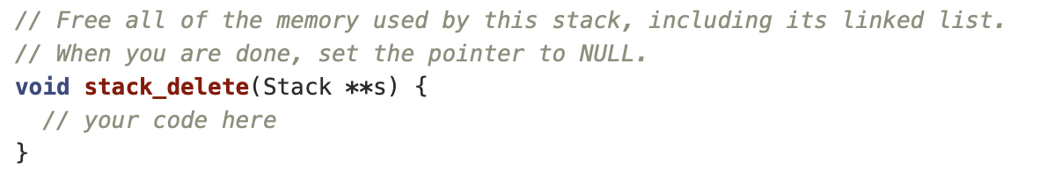
More important things
Why is it mentioning memory allocation?
  What would we want to allocate?
    Why?
Why all these pointers?
  Allows us to set the value of s to NULL once done - prevents accidentally being called later
    free(*s); *s = NULL;
  Remember to free ALL the memory used by the stack
    It is a series of nodes, and you want to free all of them

Slide 37
Some more important things
We allocate nodes when pushing onto the stack
  When popping values off the stack, look at your push operation
    What things do you have to undo?
Stack is just a struct that contains a pointer to the most recently inserted node (The top of the stack)

